Slide 1
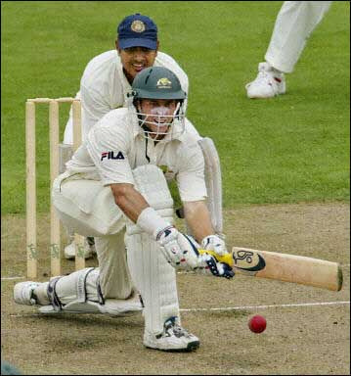
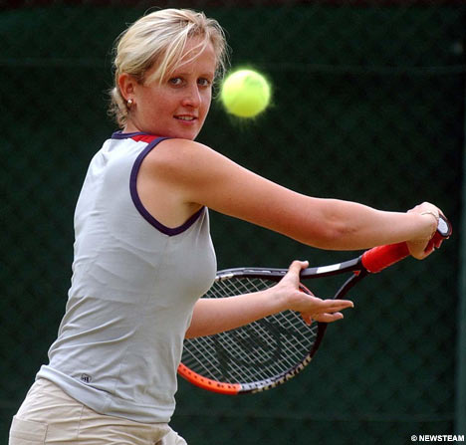
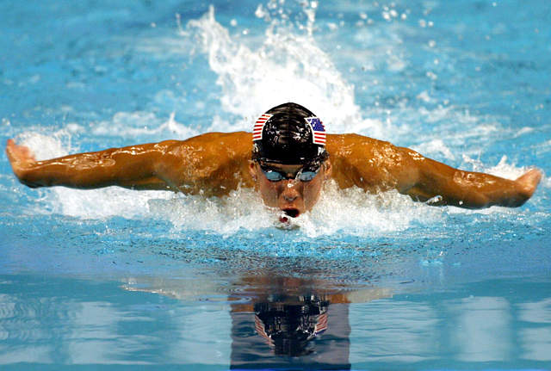
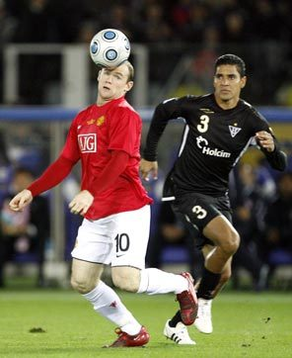
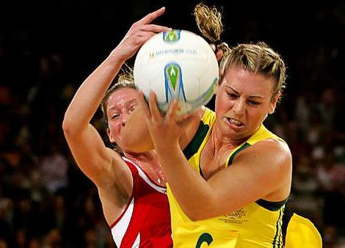
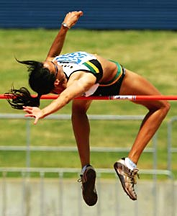
ACTIVATE and ENERGISE your best you!

Slide 2
“Choose a job you love and you’ll never work a day in your life.” Tom Connellan

Slide 3
Schedules and
Variety
Keep the body guessing.
Pace judgement and patience.
“Hang in there.”

Slide 4
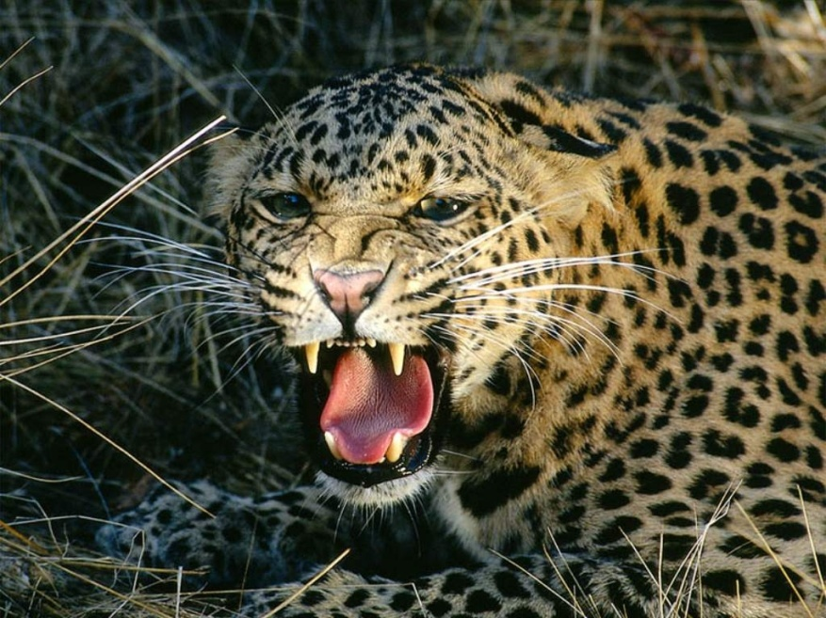
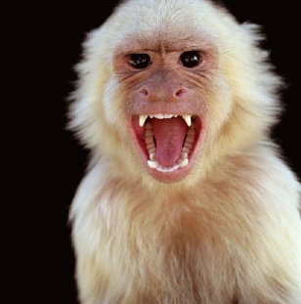
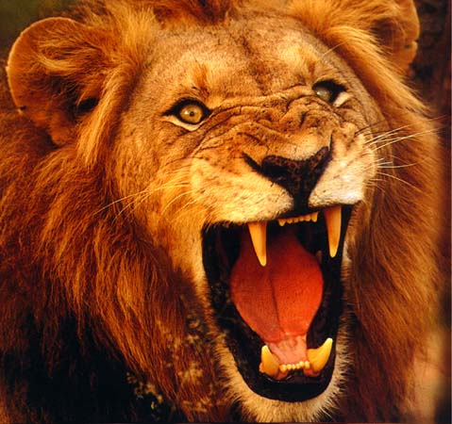
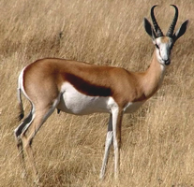
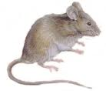
What kind of animal are you.

Slide 5
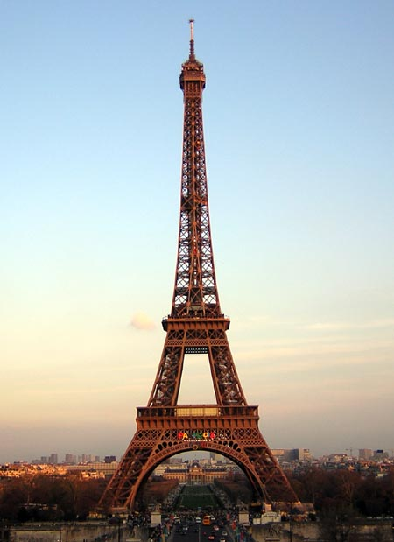
B-A-L-A-N-C-E-!
You can be too focused
Honeymoon in Paris
Sun City 2000

Slide 6
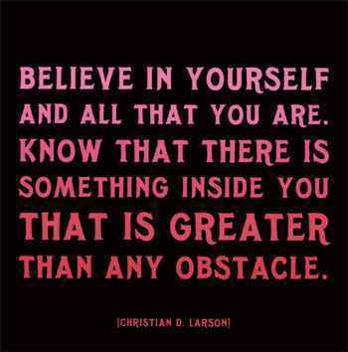
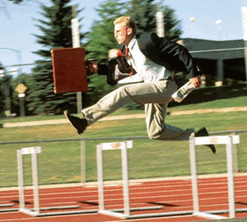
Obstacles
Respond rather than react
Breathe!!
“The stiffest trees are most easily cracked while the bamboo survives by bending with the wind” (quote by Bruce Lee)
Everything is as it is.

Slide 7
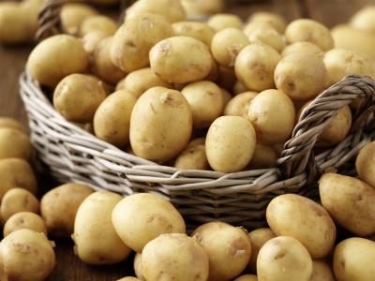
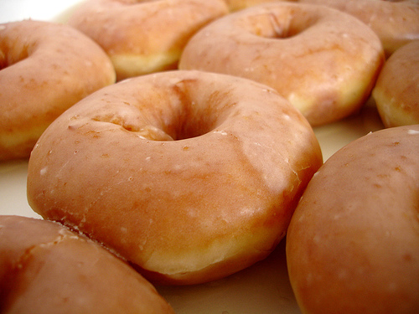
Eating for Energy
Energy sapping food
Refined carbohydrates vs Unrefined carbohydrates
Your personal pH
Protein
Essential Vitamins and Minerals
Essential and Easy Exercise

Slide 8
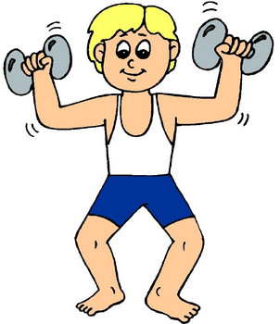
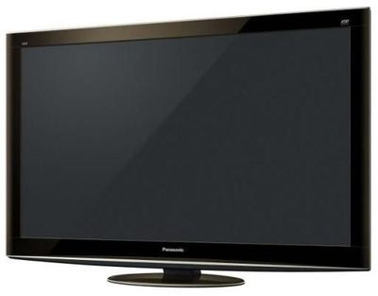
Essential Exercise
“He who is not content with what he has, would
not be content with what he’d like to have”

